Slide 1


Chapter
7
Hypothesis Testing with One Sample

Slide 2
Chapter Outline
7.1 Introduction to Hypothesis Testing
7.2 Hypothesis Testing for the Mean (σ Known)
7.3 Hypothesis Testing for the Mean (σ Unknown)
7.4 Hypothesis Testing for Proportions
7.5 Hypothesis Testing for Variance and Standard
Deviation
.

Slide 3
Section 7.2
Hypothesis Testing for the Mean
(σ Known)
.
<number> of 101

Slide 4
Section 7.2 Objectives
How to find and interpret P-values
How to use P-values for a z-test for a mean μ when σ is known
How to find critical values and rejection regions in the standard normal distribution
How to use rejection regions for a z-test for a mean μ when σ is known
.

Slide 5
Using P-values to Make a Decision
Decision Rule Based on P-value
To use a P-value to make a conclusion in a hypothesis test, compare the P-value with α.
  If P ≤ α, then reject H₀.
  If P > α, then fail to reject H₀.
.

Slide 6
Example: Interpreting a P-value
The P-value for a hypothesis test is P = 0.0237. What is your decision if the level of significance is
α = 0.05?
α = 0.01?
Solution:
Because 0.0237 < 0.05, you should reject the null hypothesis.
Solution:
Because 0.0237 > 0.01, you should fail to reject the null hypothesis.
.

Slide 7
Finding the P-value for a Hypothesis Test
After determining the hypothesis test’s standardized test statistic and the test statistic’s corresponding area, do one of the following to find the P-value.
For a left-tailed test, P = (Area in left tail).
For a right-tailed test, P = (Area in right tail).
For a two-tailed test, P = 2(Area in tail of standardized
test statistic).
.

Slide 8
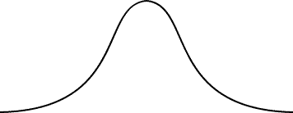
Example: Finding the P-value for a
Left-Tailed Test
Find the P-value for a left-tailed hypothesis test with a test statistic of z = −2.23. Decide whether to reject H₀ if the level of significance is α = 0.01.
Solution:
For a left-tailed test, P = (Area in left tail)
P = 0.0129
− 2.23
0
z
Because 0.0129 > 0.01, you should fail to reject H₀.
.

Slide 9
Example: Finding the P-value for a
Two-Tailed Test
Find the P-value for a two-tailed hypothesis test with a test statistic of z = 2.14. Decide whether to reject H₀ if the level of significance is α = 0.05.
Solution:
For a two-tailed test, P = 2(Area in tail of standardized
test statistic)
1 – 0.9838 = 0.0162
P = 2(0.0162)
= 0.0324
0.9838
0
2.14
z
Because 0.0324 < 0.05, you should reject H₀.
.

Slide 10

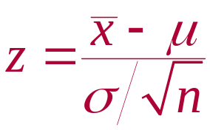
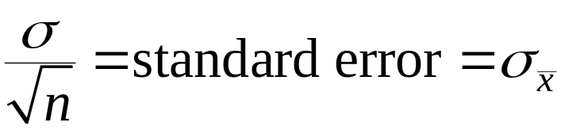
z-Test for a Mean μ
Can be used when
Sample is random
The population is normally distributed, or for any population when the sample size n is at least 30.
The test statistic is the sample mean
The standardized test statistic is z
σ is known.
.

Slide 11
Using P-values for a z-Test for Mean μ
In Words In Symbols
Verify that σ is known, the sample is random, and either the population is normally distributed or n ≥ 30.
State the claim mathematically and verbally. Identify the null and alternative hypotheses.
Specify the level of significance.
State H₀ and H_{a}.
Identify α.
.

Slide 12
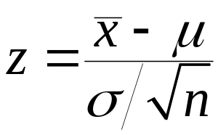
Using P-values for a z-Test for Mean μ
In Words In Symbols
Find the standardized test statistic.
Find the area that corresponds
to z.
Find the P-value.
Use Table 4 in Appendix B.
left-tailed test, P = (Area in left tail).
right-tailed test, P = (Area in right tail).
two-tailed test, P = 2(Area in tail of standardized test statistic).
.

Slide 13
Using P-values for a z-Test for Mean μ
In Words In Symbols
Make a decision to reject or
fail to reject the null hypothesis.
Interpret the decision in the
context of the original claim.
If P ≤ α, then reject H_{0.} Otherwise, fail to reject H_{0.}
.

Slide 14
Example: Hypothesis Testing Using P-values
In auto racing, a pit crew claims that its mean pit stop time (for 4 new tires and fuel) is less than 13 seconds. A random selection of 32 pit stop times has a sample mean of 12.9 seconds. Assume the population standard deviation is 0.19 second. Is there enough evidence to support the claim at α = 0.01? Use a P-value.
.

Slide 15
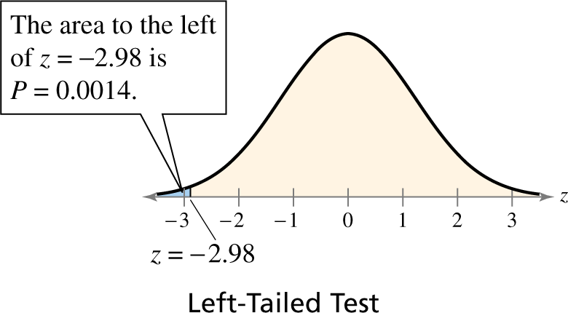
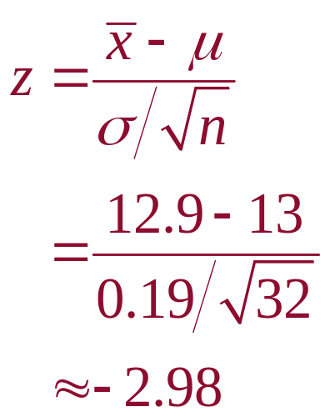
Solution: Hypothesis Testing Using P-values
P-value
H₀:
H_{a}:
α =
Test Statistic:
μ ≥ 13 sec
μ < 13 sec
0.01
Decision:
0.0014 < 0.01
Reject H₀
At the 1% level of significance, you have sufficient evidence to conclude the mean pit stop time is less than 13 seconds.
.

Slide 16
Example: Hypothesis Testing Using P-values
According to a study, the mean cost of bariatric (weight loss) surgery is $21,500. You think this information is incorrect. You randomly select 25 bariatric surgery patients and find that the average cost for their surgeries is $20,695. The population standard deviation is known to be $2250 and the population is normally distributed. Is there enough evidence to support your claim at α = 0.05?
Use a P-value.
.

Slide 17
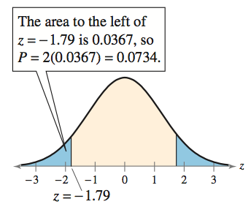
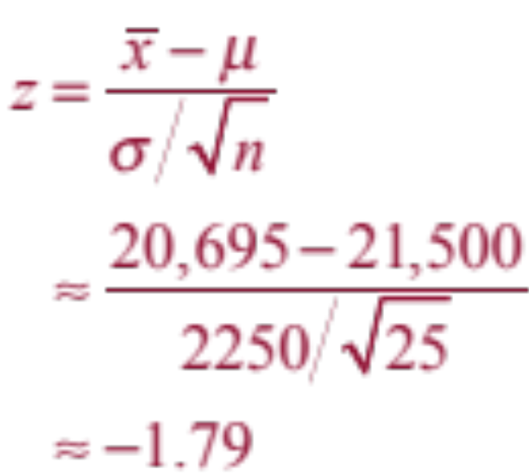
Solution: Hypothesis Testing Using P-values
P-value
H₀:
H_{a}:
α =
Test Statistic:
μ = $21,500
μ ≠ 21,500
0.05
Decision:
0.0734 > 0.05
Fail to reject H₀
At the 5% level of significance, there is not sufficient evidence to support the claim that the mean cost of bariatric surgery is different from $21,500.
.

Slide 18
Rejection Regions and Critical Values
Rejection region (or critical region)
The range of values for which the null hypothesis is not probable.
If a test statistic falls in this region, the null hypothesis is rejected.
A critical value z₀ separates the rejection region from the nonrejection region.
.

Slide 19
Rejection Regions and Critical Values
Finding Critical Values in a Normal Distribution
Specify the level of significance α.
Decide whether the test is left-, right-, or two-tailed.
Find the critical value(s) z₀. If the hypothesis test is
  left-tailed, find the z-score that corresponds to an area of α,
  right-tailed, find the z-score that corresponds to an area of 1 – α,
  two-tailed, find the z-score that corresponds to ½α and 1 – ½α.
Sketch the standard normal distribution. Draw a vertical line at each critical value and shade the rejection region(s).
.

Slide 20
Example: Finding Critical Values for a Two- Tailed Test
Find the critical value and rejection region for a two-tailed test with α = 0.05.
Solution:
1 – α = 0.95
½α = 0.025
½α = 0.025
z₀
0
z₀
z
-z₀ = -1.96
z₀ = 1.96
The rejection regions are to the left of −z₀ = −1.96 and to the right of z₀ = 1.96.
.

Slide 21

Decision Rule Based on Rejection Region
To use a rejection region to conduct a hypothesis test, calculate the standardized test statistic, z. If the standardized test statistic
is in the rejection region, then reject H₀.
is not in the rejection region, then fail to reject H₀.
Fail to reject H_{0.}
Fail to reject H_{o.}
Reject H_{0.}
Reject H_{o.}
z < z₀
z
z
z₀
z₀
z > z₀
0
Fail to reject H₀
0
Left-Tailed Test
Right-Tailed Test
Reject H₀
Reject H₀
z
z < -z₀
−z₀
0
z₀
z > z₀
Two-Tailed Test
.

Slide 22
Using Rejection Regions for a z-Test for Mean μ (σ Known)
In Words In Symbols
Verify that σ is known, the
sample is random, and either
the population is normally
distributed or n ≥ 30.
State the claim
mathematically and verbally.
Identify the null and
alternative hypotheses.
Specify the level of
significance.
State H₀ and H_{a}.
Identify α.
.

Slide 23
Using Rejection Regions for a z-Test for Mean μ (σ Known)
In Words In Symbols
Determine the critical value(s).
Determine the rejection regions(s).
Find the standardized test statistic and sketch the sampling distribution.
Use Table 4 in Appendix B.
.

Slide 24
Using Rejection Regions for a z-Test for Mean μ (σ Known)
In Words In Symbols
Make a decision to reject or
fail to reject the null hypothesis.
Interpret the decision in the
context of the original claim.
If z is in the rejection region, then reject H₀. Otherwise, fail to reject H₀.
.

Slide 25

Example: Testing Using a Rejection Region
Employees at a construction and mining company claim that the mean salary of the company’s mechanical engineers is less than that of the one of its competitors, which is $68,000. A random sample of 20 of the company’s mechanical engineers has a mean salary of $66,900. Assume the population standard deviation is $5500 and the population is normally
distributed. At α = 0.05, test the
employees’ claim.
.

Slide 26
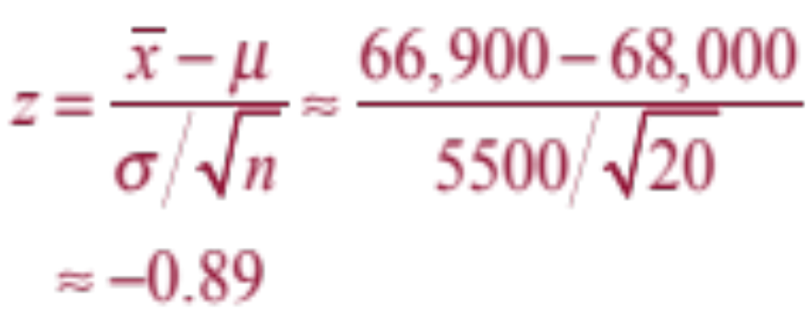
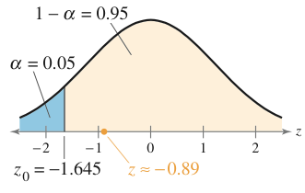
Solution: Testing Using a Rejection Region
H₀:
H_{a}:
α =
Rejection Region:
μ ≥ $68,000
Test Statistic
μ < $68,000
0.05
Decision:
Fail to reject H₀
At the 5% level of significance, there is not sufficient evidence to support the employees’ claim that the mean salary is less than $68,000.
.

Slide 27

Example: Testing Using Rejection Regions
A researcher claims that the mean cost of raising a child from birth to age 2 by husband-wife families in the U.S. is $13,960. A random sample of 500 children (age 2) has a mean cost of $13,725. Assume the population standard deviation is $2345. At α = 0.10, is there enough evidence to reject the claim? (Adapted from U.S. Department of Agriculture Center for Nutrition Policy and Promotion)
.

Slide 28
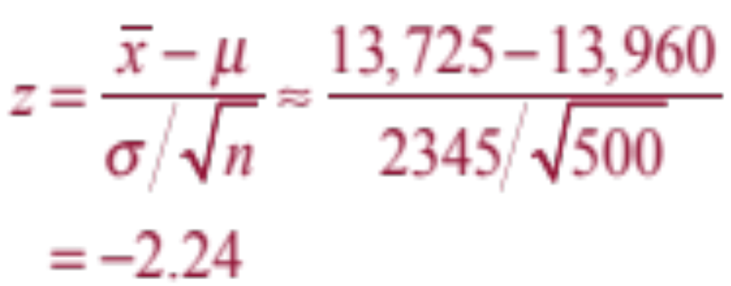
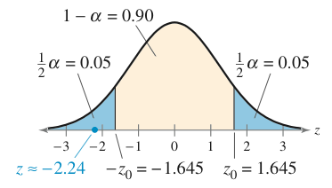
Solution: Testing Using Rejection Regions
H₀:
H_{a}:
α =
Rejection Region:
μ = $13,960
Test Statistic
μ ≠ $13,960
0.10
Decision:
Reject H₀
At the 10% level of significance, you have enough evidence to reject the claim that the mean cost of raising a child from birth to age 2 by husband-wife families in the U.S. is $13,960.
.

Slide 29
Section 7.2 Summary
Found and interpreted P-values and used them to test a mean μ
Used P-values for a z-test for a mean μ when σ is known
Found critical values and rejection regions in the standard normal distribution
Used rejection regions for a z-test for a mean μ when σ is known
.

